Slide 1
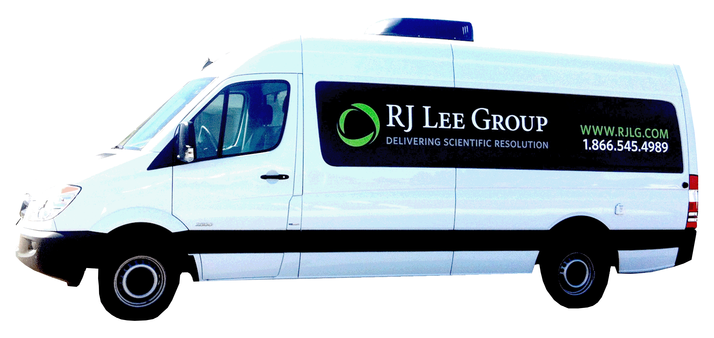
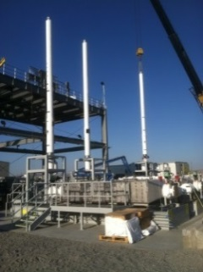
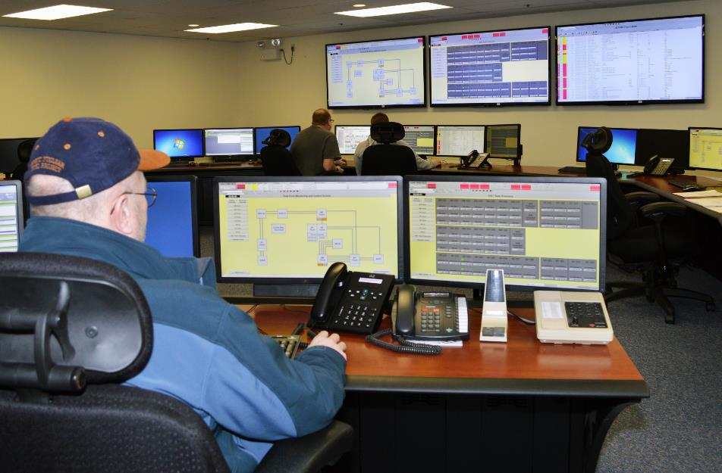
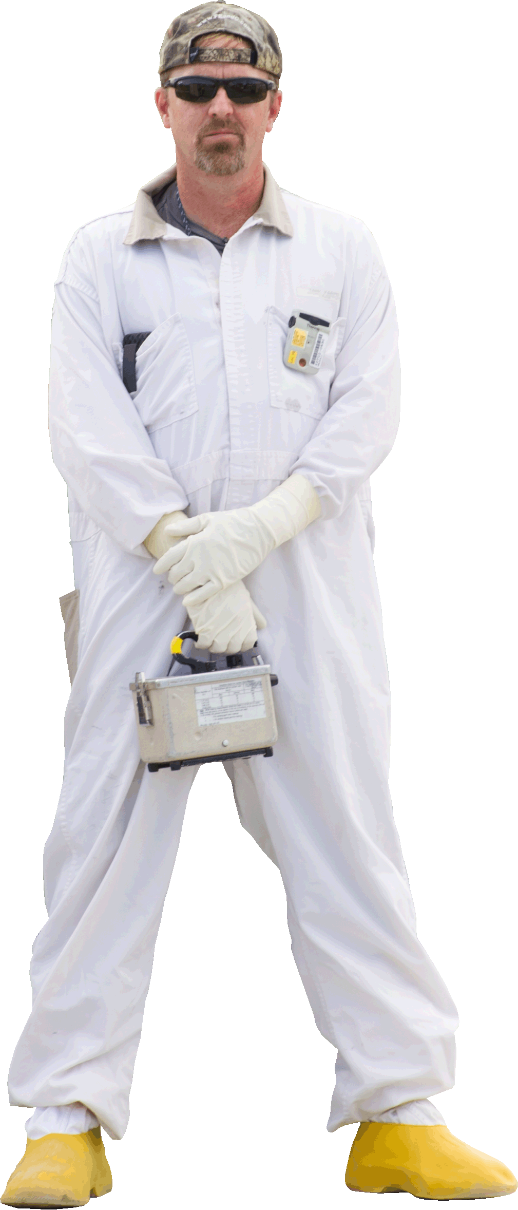
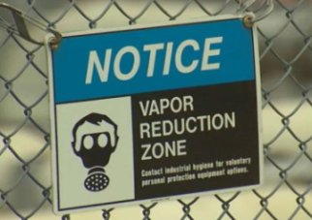
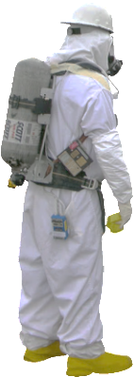
Farm of the Future
TVAT
Recommendations
Current/Future Actions
Mitigate
Hazard
Tank Farm of the Future
Engineering Controls
Intermediate Actions
Administrative Controls
initial Actions
The Future is NOW
PPE
Greater Reliance on Technologies
and Engineered Controls
Ensures farm boundaries are protective/safe
Provides centralized command and control
Implements comprehensive plan inside/outside farm boundary
Rigorous identification and response to:
Tank vapors
Farm vapors
Site vapors
Greater Reliance on Cumbersome Protective Gear

Slide 2
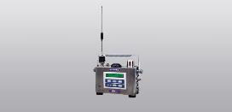
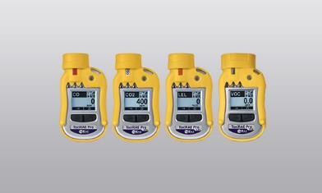
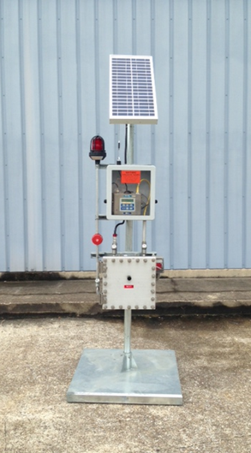


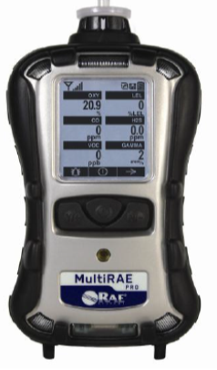
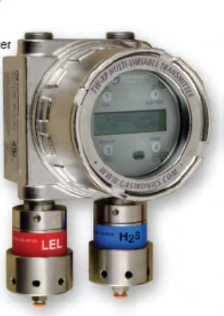
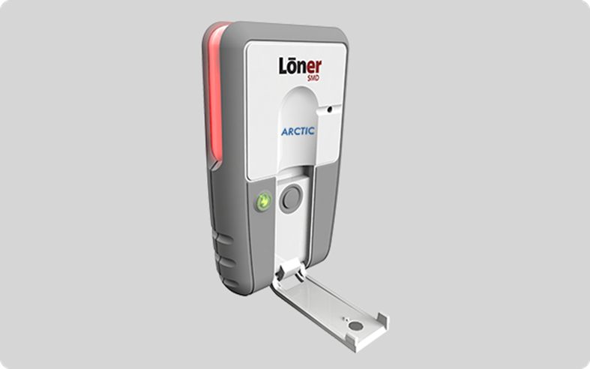
Farm of the Future
Current/Future Actions
Mitigate
Hazard
TVAT
Recommendations
MultiRAE
Intermediate Actions
ToxiRAE-VOC (PID)
Engineering Controls
AreaRAE
Tank Farm
of the Future
Administrative Controls
FLIR Cameras
MeshGuard-NH3
initial Actions
Meteorological Stations
Greater Reliance on Technologies
and Engineered Controls
MultiRAE
IR/UV Sensors
Instrument gauge
PPE
HAZ Scanners
Blackline GPS
Technologies under evaluation
(shown for illustrative purposes)
Ensures farm boundaries are protective/safe
Provides centralized command and control
Implements comprehensive plan inside/outside farm boundary
Rigorous identification and response to:
Tank vapors
Farm vapors
Site vapors
Mobile Organic Monitoring Lab

Slide 3
Communications Plan
Increase trust/confidence through frequent transparent information sharing
WORKERS
All-Employee Meetings
All-Employee Messages
Employee Briefings
CVST Communication Sub-teams
Newsletter Articles
Web
Data
Phoenix
Fact Sheets
Q&As
STAKEHOLDERS
HAB Updates
Congressional Calls
Web
Data
Phoenix
Fact Sheets
Q&As
Chemical
Protection
Program Office
PUBLIC
HAB Updates
Congressional Calls
Web
Data
Phoenix
Fact Sheets
Q&As
PR Firm
Media

